Slide 1


BARGAIN BOT
Get Your Budget Estimated

Slide 2

PRESENTED BY:
Gul-e-Zahra 2022-CS-75
Amna Nadeem 2022-CS-96

Slide 3
TABLE OF CONTENTS
Introduction
Models
Technology Stack
Work Flow
Challenges
Future Improvements
Conclusion

Slide 4
INTELLIGENT SYSTEM FOR ESTIMATING PROJECT BUDGETS.
Key Features
Project type inquiries
Complexity scoring
Budget forecasting

Slide 5

MODELS
Linear Regression
Assumes perfect linearity between features and target.
Lacks regularization techniques (e.g., for multicollinearity).
Random Forest Regressor
Simplified compared to Scikit-learn's implementation.
Missing advanced techniques like feature importance analysis.

Slide 6

TECHNOLOGY STACK
Programming Languages and Libraries
Python: Core programming language for development.
Pandas & NumPy: Data manipulation and numerical computations.
Scikit-learn: Model benchmarking and comparison.
Matplotlib & Seaborn: Data visualization.

Slide 7
TECHNOLOGY STACK
Frameworks and Tools
Streamlit: Interactive and user-friendly web interface.
Custom ML Implementations: Linear Regression and Random Forest Regressor designed from scratch.

Slide 8
TECHNOLOGY STACK
Deployment
Local Deployment: Streamlit-powered web app for local execution.
Collaboration Tools
Git & GitHub: Version control and code sharing.

Slide 9
WORK FLOW
Data Collection
Simulated historical project data.
Data Preprocessing
Cleaning and feature selection.
Addressing class imbalance.
Model Implementation
Linear Regression: Simple, interpretable predictions.
Random Forest: Handles non-linear relationships for better accuracy.
Model Evaluation
Metrics: MSE, R² Score.
Comparison: Random Forest outperforms Linear Regression.
User Interaction
Streamlit-based interface for input and budget predictions.

Slide 10

CHALLENGES
Data Noise: Impacts model accuracy and stability.
Missing Values: Current implementation lacks handling of missing data.
Robustness: Models struggle with extreme outliers or anomalies.

Slide 11

FUTURE IMPROVEMENTS
Advanced Machine Learning Libraries: Replace custom implementations with robust libraries.
Hyperparameter Tuning: Use techniques to optimize model performance.
Data Preprocessing: Implement strategies to handle noisy, incomplete, or imbalanced data.
Expand Dataset: Larger datasets for better generalization and less overfitting.

Slide 12
REAL-TIME API INTEGRATION
Fetch Live Data
Integrate with real-time APIs for live project data.
Real-Time Budget Estimations
Provide dynamic, up-to-date estimations for projects.
Seamless Workflow Integration
Connect with project management tools for enhanced usability.

Slide 13
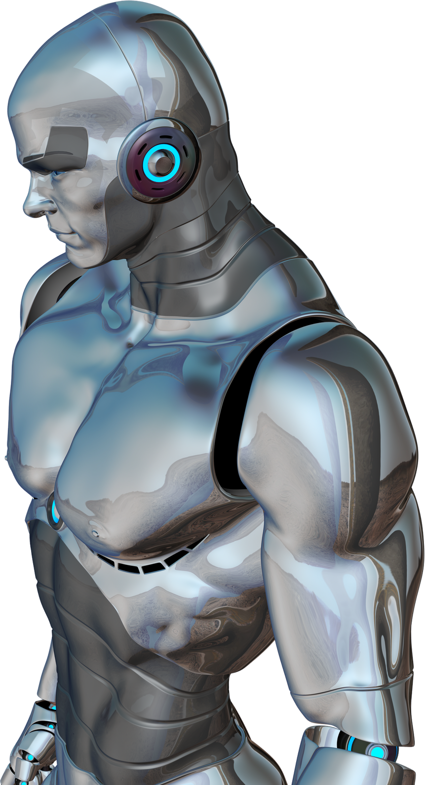
CONCLUSION
Key Achievements
Developed an intelligent system for estimating project budgets using machine learning.
Interactive UI for easy user interaction with budget forecasting.
Future Vision
Real-world data integration, advanced techniques, and feature enhancements for continuous improvement.
Potential Impact
BargainBot can be a valuable tool for businesses and individuals in project management.

Slide 14
THANK YOU!
FOR YOUR ATTENTION

